Slide 1
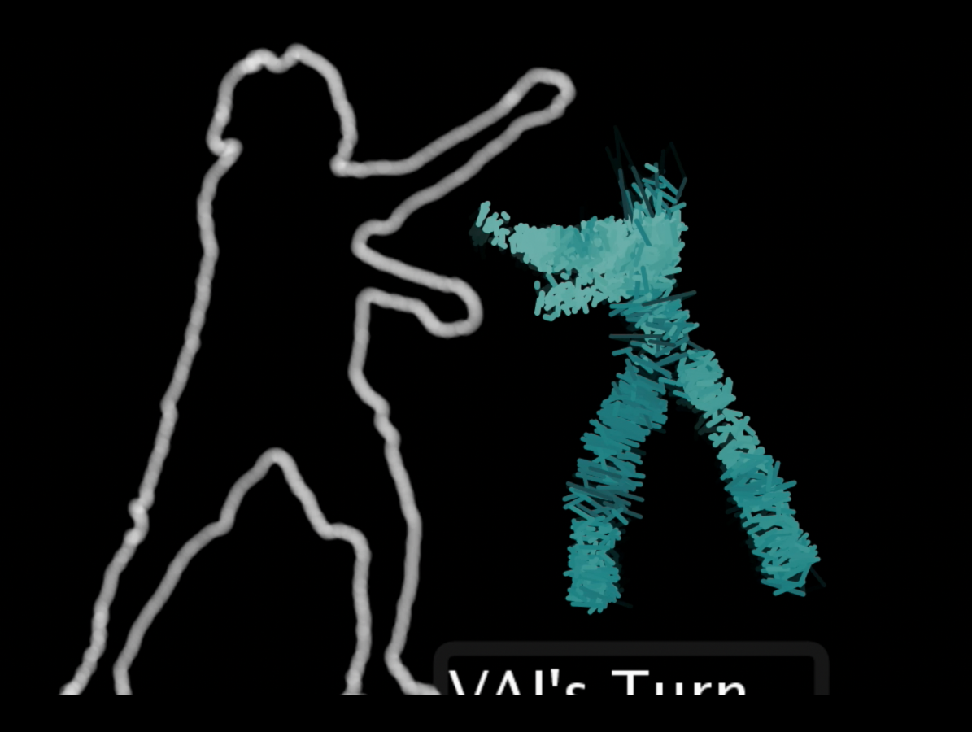


Viewpoints AI
Improvisational Dance AI
mikhail jacob ivan sysoev tory anderson brian magerko

Slide 2

aims
freeform, expressive gestural interaction
minimal instantial knowledge
improvisational proto-narrative

Slide 3

Viewpoints AI (video)

Slide 4
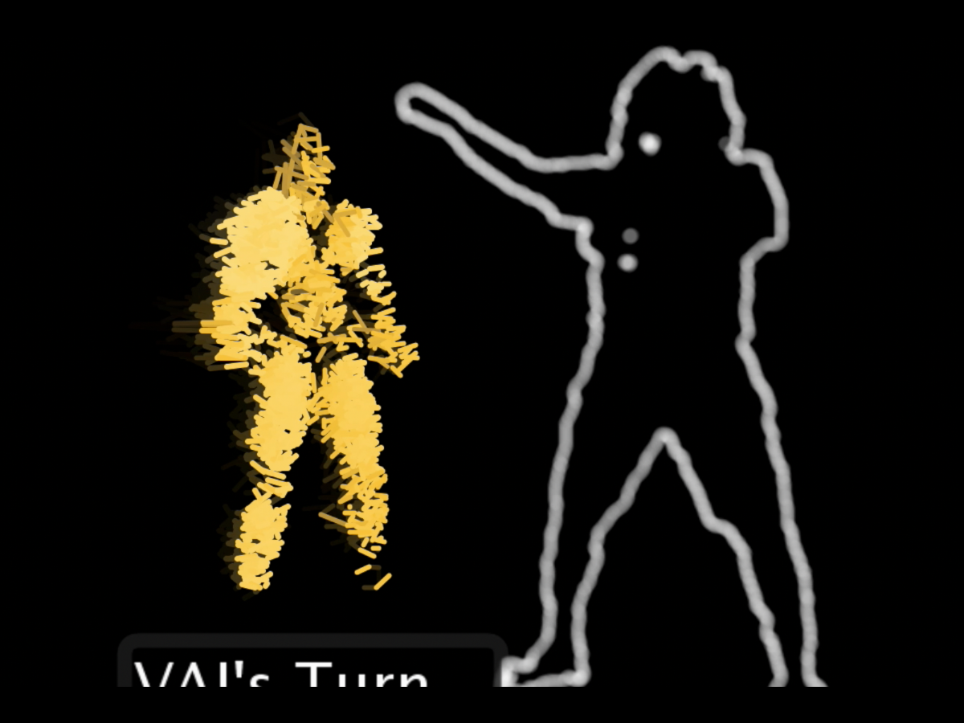
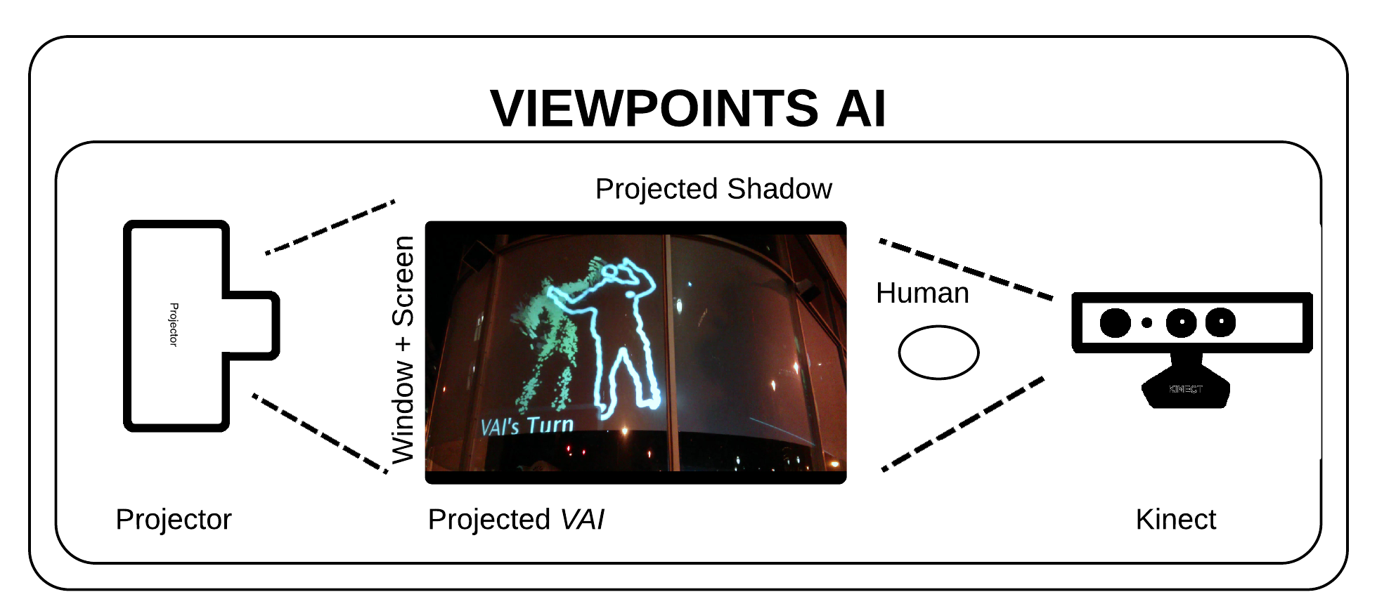
Viewpoints AI

Slide 5
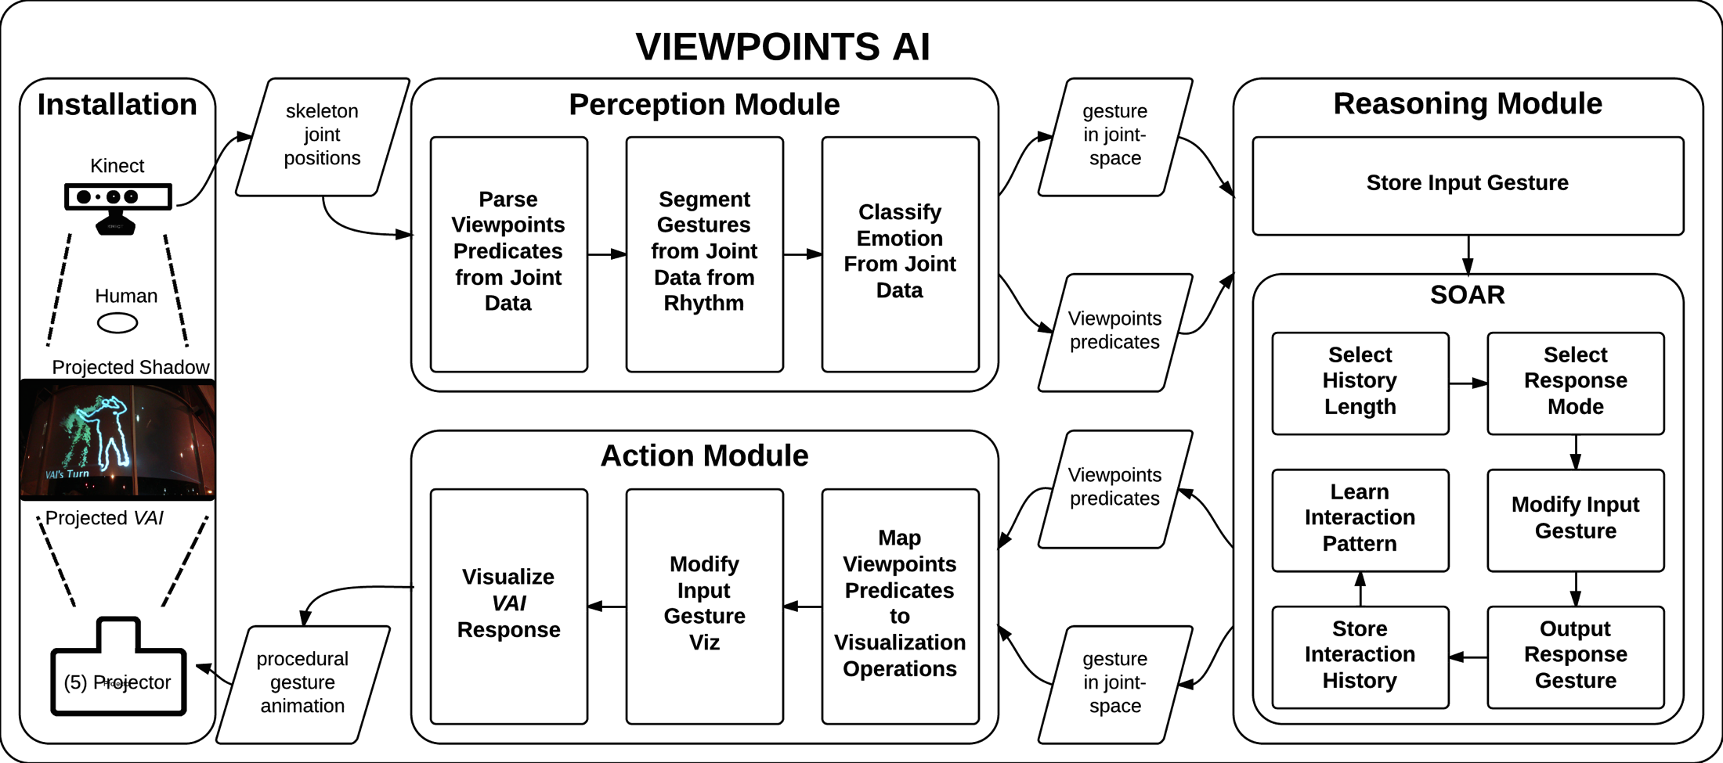
architecture

Slide 6
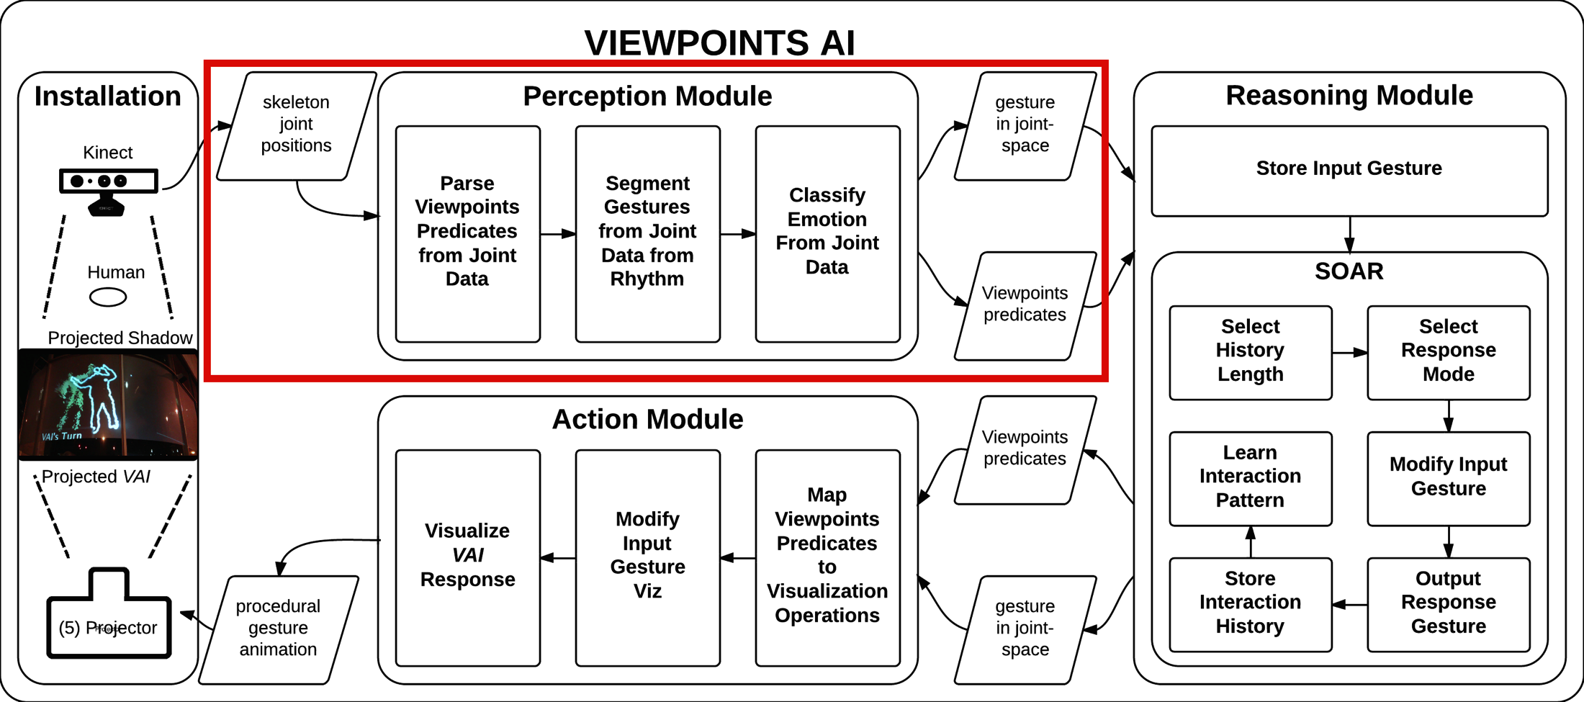
perception
TODO

Slide 7
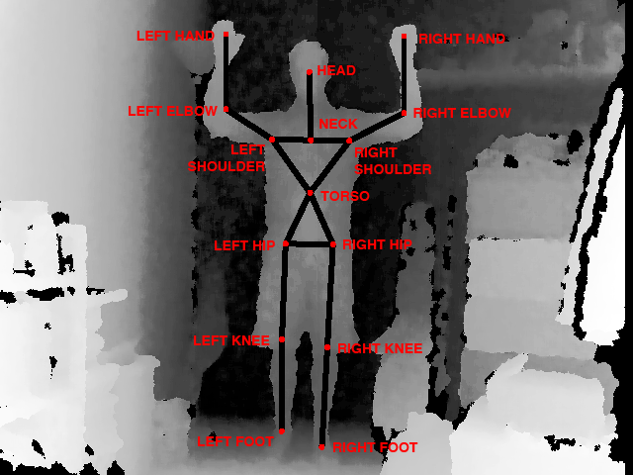
perception
parsing Viewpoints
“emotion” classification
turn-taking

Slide 8
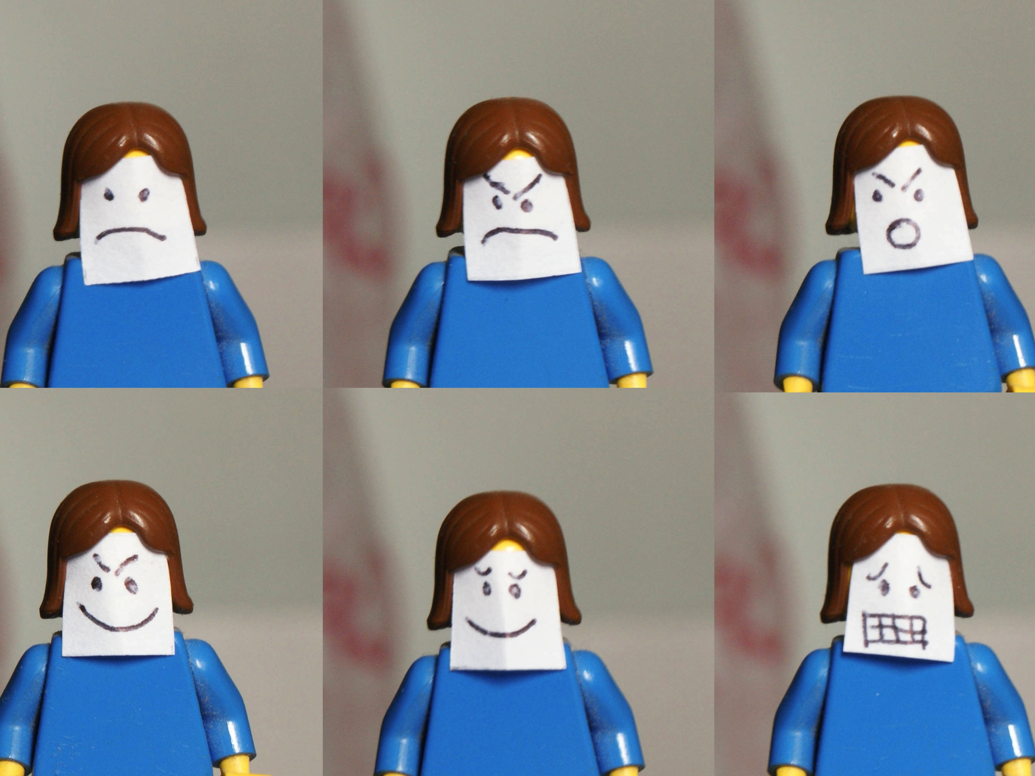
random forests classifier from scikit-learn
motion-based feature set
supervised learning
“emotion” classification

Slide 9
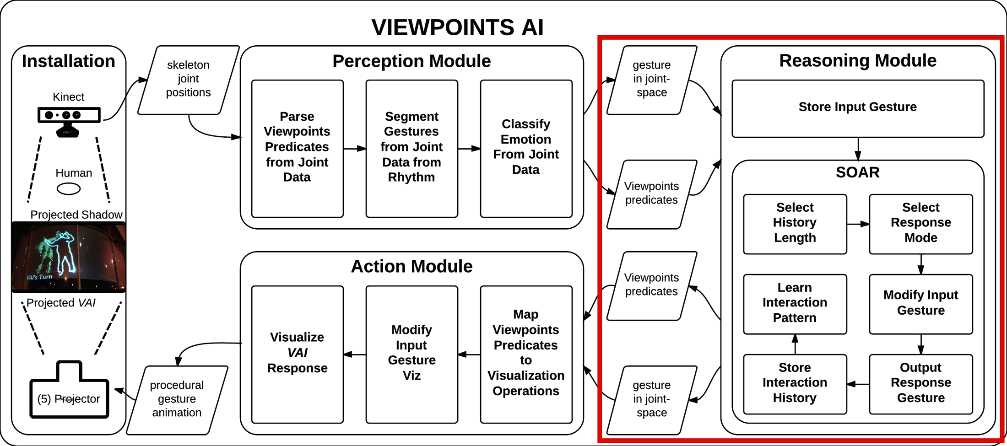
TODO
reasoning

Slide 10
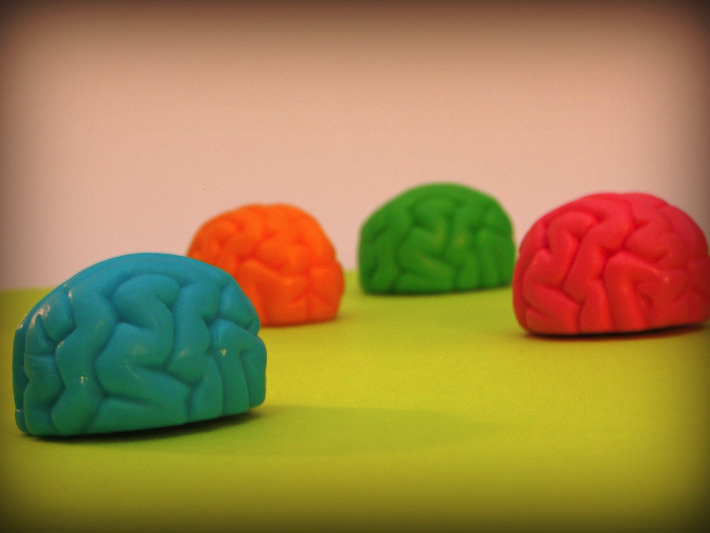
reasoning
novel to interaction context
apply learned pattern
transform
repeat
response modes
emotion algebra
no op

Slide 11

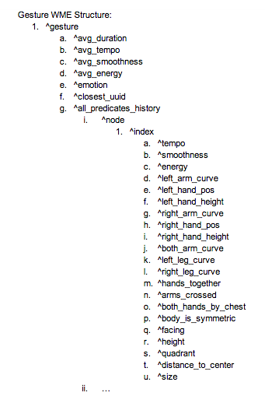
episodic memory
interaction history
“novel to interaction context” response mode
approximate gesture matching

Slide 12

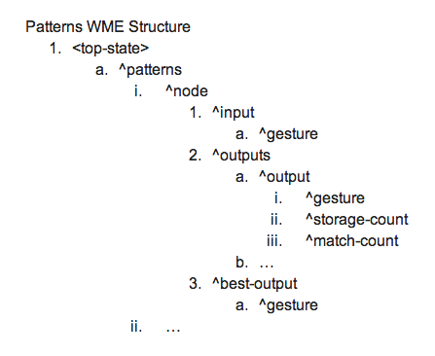
pattern learning interaction
call & response pairs
weighted by frequency of usage and observation

Slide 13
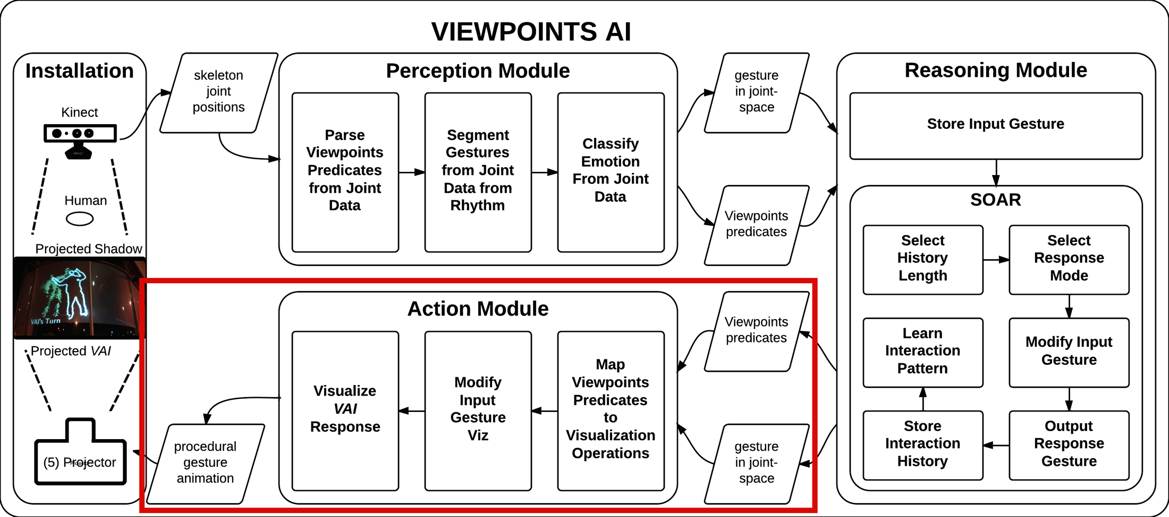
TODO
action

Slide 14

functional response modes
nuggets
data-driven interactive experience
formalized Viewpoints theory
TODO
learning by observation
approximate gesture matching via EpMem
potential application for SVS

Slide 15
naive call & response learning
only surface semantics
Viewpoints theory not utilized fully
noisy emotion classification
EpMem restrictions
limited synchronous interaction
evaluation: summer 2014
coals

Slide 16

mikhail.jacob@gatech.edu
mikhailjacob.in
adam.cc.gatech.edu

